Slide 1








Quality Dashboard
Total Task
Sample
Defects
Fatal Error
Quality Score

Slide 2

Employee Performance

Slide 3
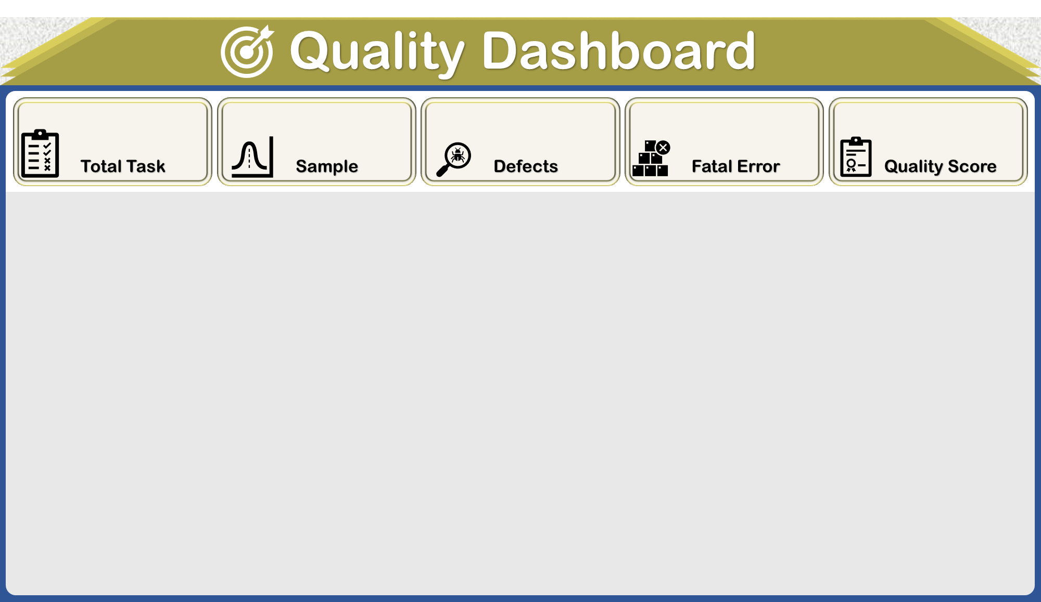

Slide 4
